Slide 1

Sachin Dalvi Data Scientist
Former project management strategist for brands such as UBC, National Bank, Willis Towers Watson

Slide 2








Burnt Base
Using YouTube data and Structural Similarity to compare and reverse search base image to return the YouTube video links for Clash of Clans
Duration: 6 Weeks
Data Source
Technologies Used

Slide 3
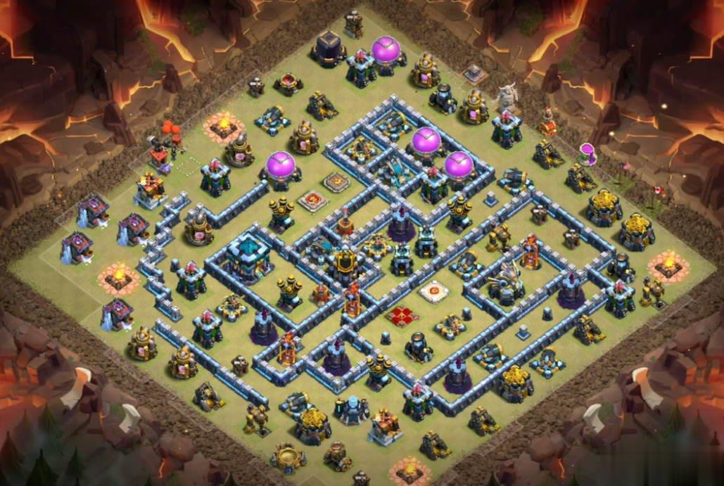
Problem Statement
Clash of Clans(COC) is an addictive game where you build a base to defend from other player attacking your base, train troops, and attack others. The goal of the attacker is to destroy all the building on the base vice a versa for defender i.e. defend as building as possible.
Now that we understand the mechanics, let's dive into the need and what problem we will solve. In 2018 Supercell introduced the world championship cup for COC, which attracted players all over the world and 2019 there was a prize pool of 1 Million US dollars at stake.
This led to extensive YouTube content creation of how to attack videos from professional gamers such as Carbonfin, ITZU etc. COC player would spend hours going through each video on YouTube to check if bases are burnt i.e. if there is a video that shows how someone else has attacked the base. This gives the Clan (Team) a huge competitive advantage.
Our model will take an image as an input and reverse search it against YouTube data and return the video link.

Slide 4
THE PROCESS
Burnt Base
DATA COLLECTIONS
Identify top 2 famous COC content creator
Create list of YouTube URL links for the top 2 COC content creators
Download frames from YouTube video using open CV
1
Model Evaluation
DATA CLEANING
2
3
Mean Squared Error (MSE)
Structural Similarity Index(SSIM)
Fine tune the model for improvements
Rename the frames images in the chronological order of their downloads
Segregate the downloaded frame images by Video ID and move them in separate folders
Final Model
4
Produce final model and test it against a various COC & Non-COC images

Slide 5
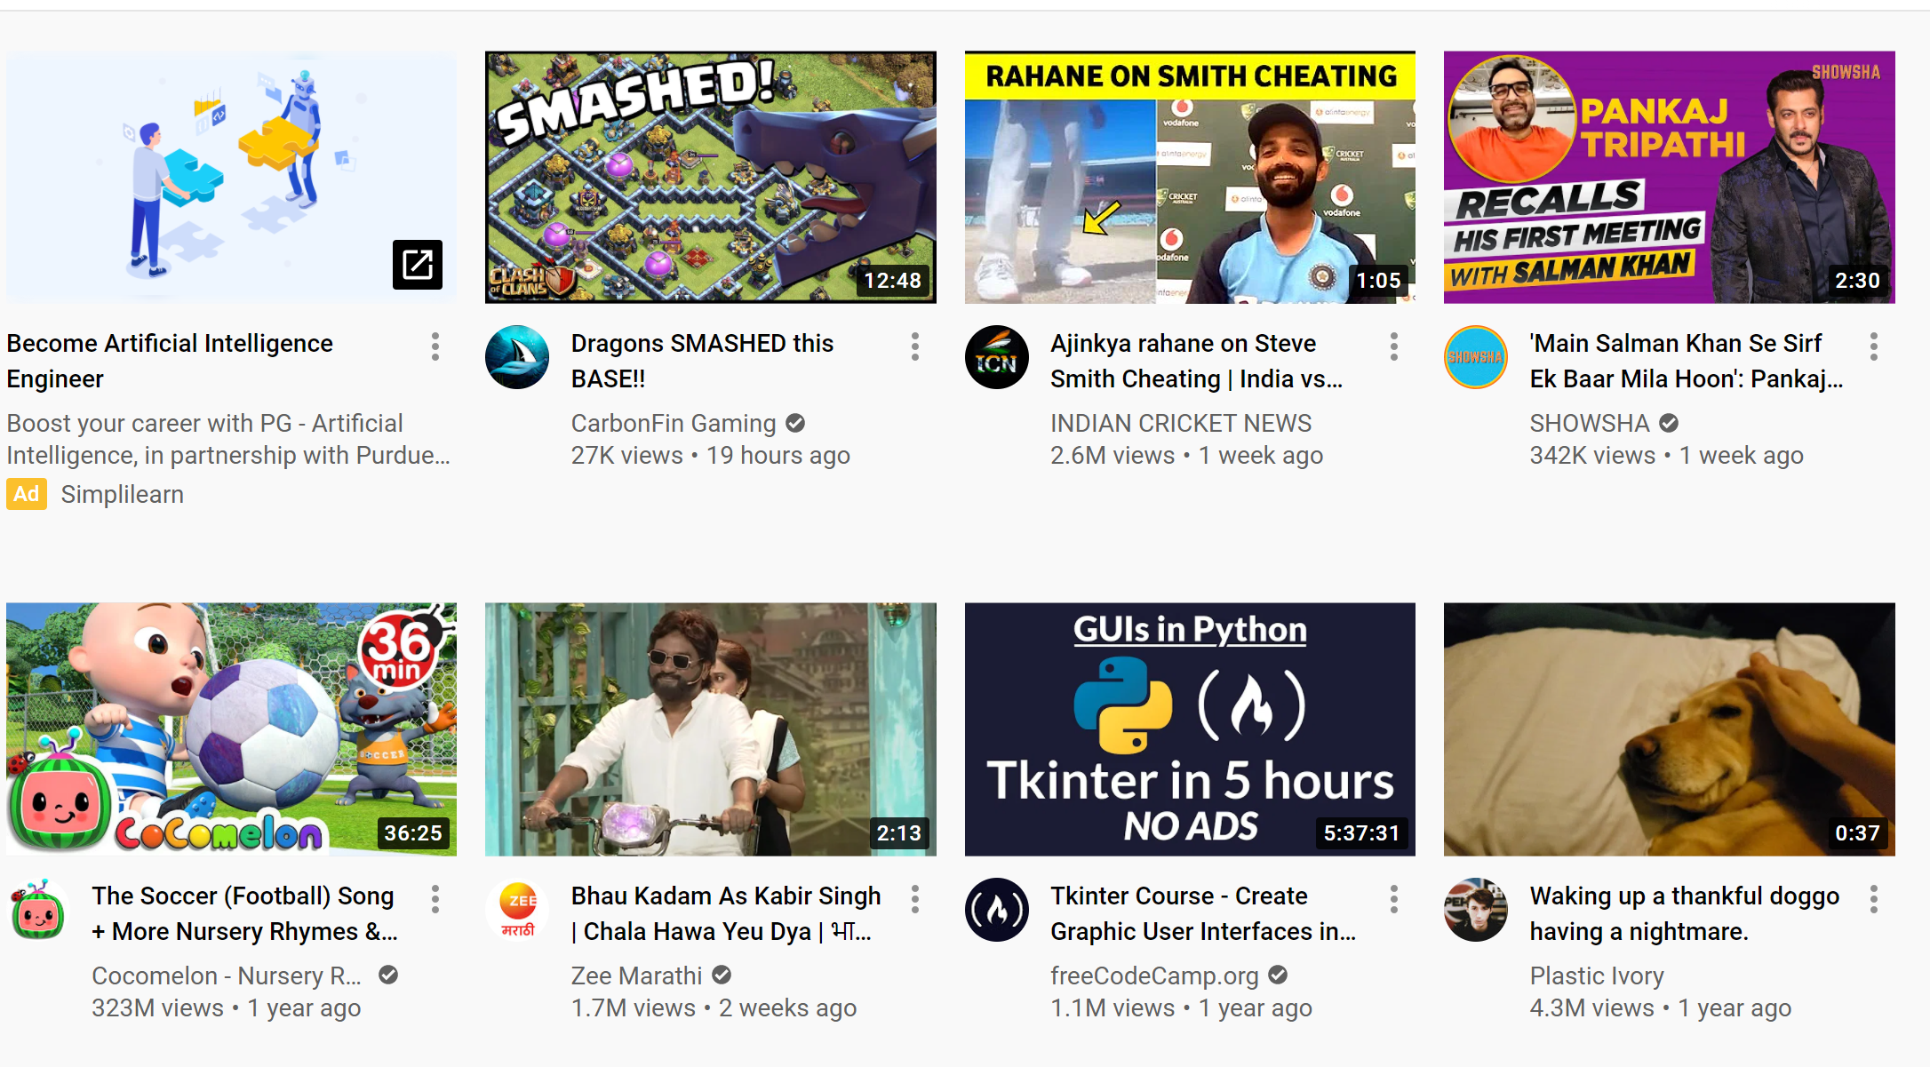
Data Collection started in YouTube, downloading frames from YouTube API
Data Collection
Web Scraping
Create list YouTube videos URL for the Top 2 Clash of Clan content creators
Once the list was ready, Frames were extracted using Python from the video using YouTube URL and Open CV

Slide 6
Data Clean-Up & Description
Burnt Base
1
2
3
4
YouTube Frames
Rename Images
Move to Folder
Rename Folder
YOUR TITLE 05
Download the frames from YouTube Videos open CV
Rename the image to capture the chronological order of the image in the Video
Move the frames of each YouTube video in separate folder
Rename each folder with corresponding YouTube Video ID
MILESTONE
START
Frames downloaded from YouTube using open cv video capture feature are collection of images that stiches together the YouTube videos

Slide 7
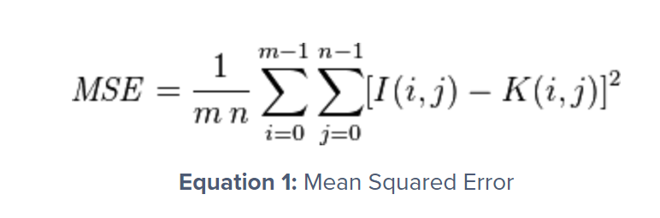
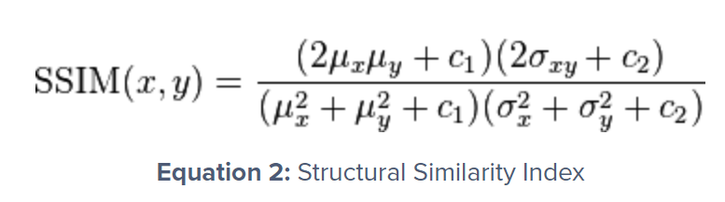
Mean Square Error
I started with using the MSE algorithm to compare the images, however I was getting false negative for the
same images with different contrast.
To overcome this MSE limitation, I used the structural similarity index algorithm which perceives the change
in structural information of the image by comparing local regions of the image instead of globally.

Slide 8
Model Evaluation
VS
Results
The SSIM method is clearly more involved than the MSE method, but the gist is that SSIM attempts to model the perceived change in the structural information of the image, whereas MSE is actually estimating the perceived errors. There is a subtle difference between the two, but the results are dramatic.
MSE will calculate the mean square error between each pixels for the two images we are comparing. Whereas SSIM will do the opposite and look for similarities within pixels; i.e. if the pixels in the two images line up and or have similar pixel density values.

Slide 9
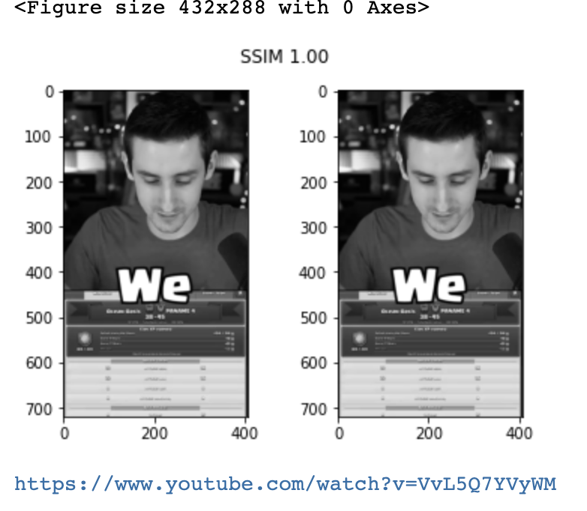
Training & Tweaking the Model
SSIM value can vary between -1 and 1, where 1 indicates perfect similarity.
Since the value is inversely correlate to image similarity, I added following control:
Return the result with highest SSIM score and corresponding YouTube link.
If SSIM was less than 0.65 return a warning with the results

Slide 10
Next Steps
Test
Tweak
Deploy
Run the model on multiple images to see if it will predict accurately
Scale the model to work for another popular games like Clash of Clan & hookup the app AWS compute power to bump up performace
Create a web app that will compare images directly on YouTube rather than local repository

Slide 11
Thank You

Slide 12
